Slide 1

Online Autonomous Paper Evaluation
Department of CSE
Jyothi Engineering College
Thrissur
November 18, 2019
CSE Department, JECC
1
Notes:
1
1
1
1

Slide 2
GROUP-7
Group Members Register No
Nova Dileep JEC17CS078
Sangeetha P JEC17CS087
San Jose JEC17CS089
Sreerag R Nandan JEC17CS099
Guide
Mrs Namitha T N,
Assistant Professor,
CSE Department
CSE Department, JECC
2

Slide 3
Vision of the Department
Creating eminent and ethical leaders in the domain of Computational Sciences through quality professional education with a focus on holistic learning and excellence.
Mission of the Department
To create technically competent and ethically conscious graduates in the field of Computer Science and Engineering by encouraging holistic learning and excellence.
To prepare students for careers in Industry, Academia and the Government.
To instill Entrepreneurial Orientation and research motivation among the students of the department.
To emerge as a leader in education in the region by encouraging teaching, learning, industry and societal connect.
CSE Department, JECC

Slide 4
Contents
Introduction
Existing System
Literature survey
Proposed system
Hardware Specifications
Software Specifications
Data Flow Diagram - Module wise
Architecture
Screenshot of Implementation
Detailed design of the project
Application and future enhancement
Conclusions
References
02/08/19
CSE Department, JECC
4
Notes:
4
4
4
4

Slide 5
Introduction
We are proposing a Computerized Autonomous Paper Evaluation system which can be used in descriptive type examination for evaluation
This system overcomes many drawbacks of the existing system and helps to improve student’s performance in a much better way
CSE Department, JECC
5
Notes:
5
5
5
5

Slide 6
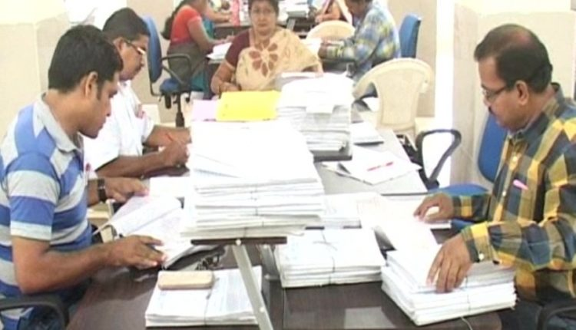
Existing System
Manual Paper Evaluation
Drawbacks
Biasness
Mistakes from the side of evaluator
Time consuming
Depends on the appearance of paper
Transportation of papers are needed
CSE Department, JECC
6
Notes:
6
6
6
6

Slide 7
Literature survey
Reference Papers:
[1] Radhika Patel and Suman K. Mitra, “Extracting Text from Degraded Document Image”,2015
[2]Tanupriya Choudhury, Kartikeya Jain, Lakshya Aggarwal, Ayushi Gupta, Garv Saxena, “Computerized Paper Evaluation Using Neural Network” ,2017
[3] Najwa-Maria Chidiac, Pascal Damien, Charles Yaacoub, “A Robust Algorithm for Text Extraction from Images”,2016
CSE Department, JECC
7
Notes:
7
7
7
7

Slide 8
Extracting Text from Degraded Document Image[1]
Technology Used:
Pre-processing: The first step is converting the RGB (colour) image to grayscale
A Principle Component Analysis (PCA) based conversion is used for this purpose
Next is a chain of basic image processing techniques to improve local contrast and suppressing these from background texture in order to efficiently detect text region motivated by where illumination variations is addressed
CSE Department, JECC
8
Notes:
8
8
8
8

Slide 9
Text area detection: Identifies text area using Rough set theory.
Post processing: Takes care of false positives and negatives based on intensity values of pre-processed and gray image
CSE Department, JECC
9
Notes:
9
9
9
9

Slide 10
Advantages:
Binarization in pre-processing provides almost zero loss of text area
Provides satisfactory result in text preservation of degraded images
Does not depend on text size and stroke width
Disadvantage:
Presence of undesired black and white blobs
CSE Department, JECC
10

Slide 11
Computerised paper evaluation using neural network[2]
Technology used:
Image processing: Pre-processing of picture is performed using grayscale, obscure, edge and diminishing of the picture
Training: Training of the proposed framework is by using Self Organizing Maps ANN
Detection: System identified characters are matched with those in the database and ranking of the student is performed
CSE Department, JECC
11
Notes:
11
11
11
11

Slide 12
Advantages:
No biasness
Not time consuming
Appearance of paper is not considered
Does not require transportation
Disadvantages:
Less adapted to noise
Low Accuracy
CSE Department, JECC
12

Slide 13
A robust algorithm for text extraction from images[3]
Technology used:
MSER : Detects all text regions regardless of size and font and distinguish them from non-text regions
Stroke width detector: Enhanced MSER images are fed into this detector and different components are filtered according to set of geometric rules
CSE Department, JECC
13
Notes:
13
13
13
13

Slide 14
Advantages:
Effective on blurred and noisy images
13% significant improvement compared to existing text extraction approach using normal MSER
Disadvantages:
Algorithm failed to detect text with shadowing effect
Failed to detect text with characters of small size and thin strokes
CSE Department, JECC
14

Slide 15
Inference
Reference Paper | Extracting Text from Degraded Document Image | A Robust Algorithm for Text Extraction from Images | Computerized Paper Evaluation Using Neural Network
Use Case | To extract text from old degraded low quality documents | To extract text from image in even in low lighting and moderate Noise condition | To evaluate paper using self organising map
Key Technology | PCA based conversion, Edge Detection Using Rough-Set Theory | Maximally Stable Extremal Regions (MSER) detection, Stroke Width Detector | Self Organizing Maps(SOM)
CSE Department, JECC
15

Slide 16
Proposed system
Proposed system
It is an online paper evaluation system that uses the technology of image processing
First the answer sheets are scanned into the computer
Compared with the predefined answer key
Marks are recorded accordingly
Page for suggestion/improvement is appended
CSE Department, JECC
16

Slide 17
Hardware and software specifications
Hardware requirements
Scanner (HP Scan Jet G3110)
CPU with intel i7 processor 16 GB RAM
CSE Department, JECC

Slide 18
Software requirements
Ubuntu 18.04
Scanner device drive (HP Scan Jet G3110 device drive)
Python3
Jupyter Notebook
MySQL database
CSE Department, JECC

Slide 19
Module Description
Module 1-Admin Interface
Super user logins to the system
Uploads the answer paper and answer key in database
CSE Department, JECC

Slide 20
Module 2- Preprocessing and Feature extraction
Preprocessing of answer sheet is performed
Only required features are extracted from answer sheet
Extracted features are stored in database
CSE Department, JECC

Slide 21
Module 3-Evaluation
Features and answer key are compared
Evaluation is performed accordingly
Marks are awarded
Suggestion page is appended
CSE Department, JECC

Slide 22
LEVEL-0 Data Flow Diagram
EXAM PAPER
Scan
Evaluation
Marks
Predicts
CSE Department, JECC

Slide 23
LEVEL-1 Data Flow Diagram
Module 1
Super User
Login
Answer key /
Answer paper
CSE Department, JECC
23

Slide 24
LEVEL-1 Data Flow Diagram
Module 2
Pre Process
Answer paper
Features
CSE Department, JECC

Slide 25
LEVEL-1 Data Flow Diagram
Module 3
Answer key
Valuation
Marks/Suggestions
Features
CSE Department, JECC

Slide 26
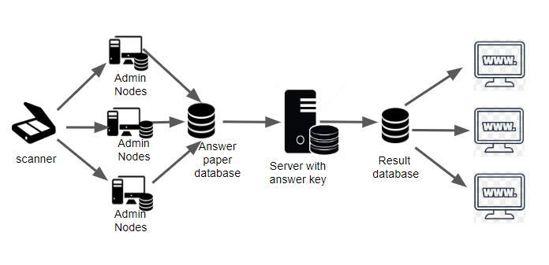
ARCHITECTURE
CSE Department, JECC

Slide 27

Screenshot of implementation
CSE Department, JECC

Slide 28
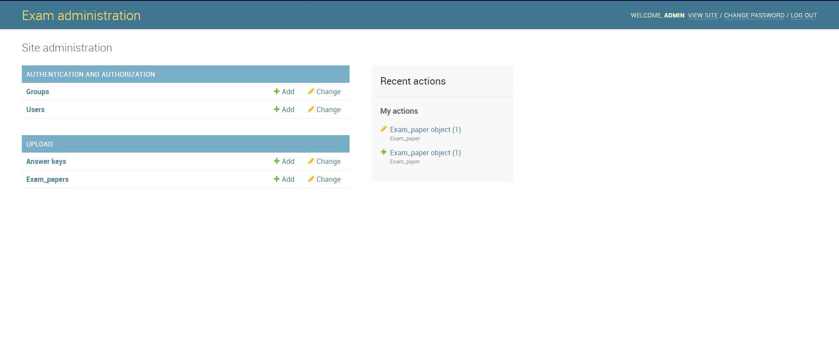
CSE Department, JECC

Slide 29
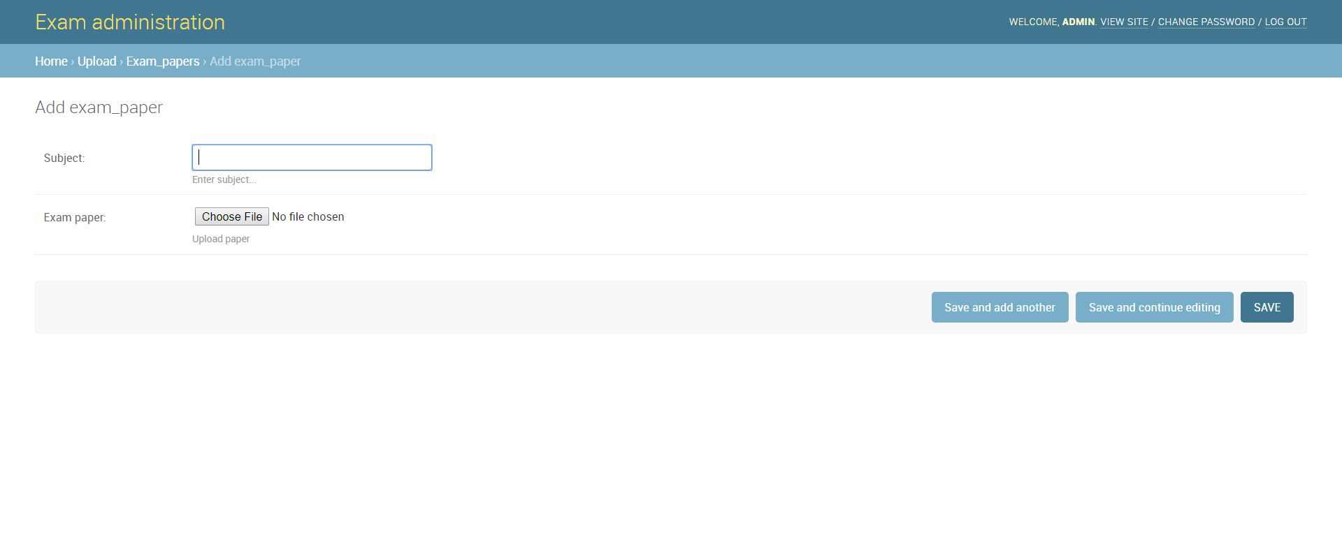
CSE Department, JECC

Slide 30
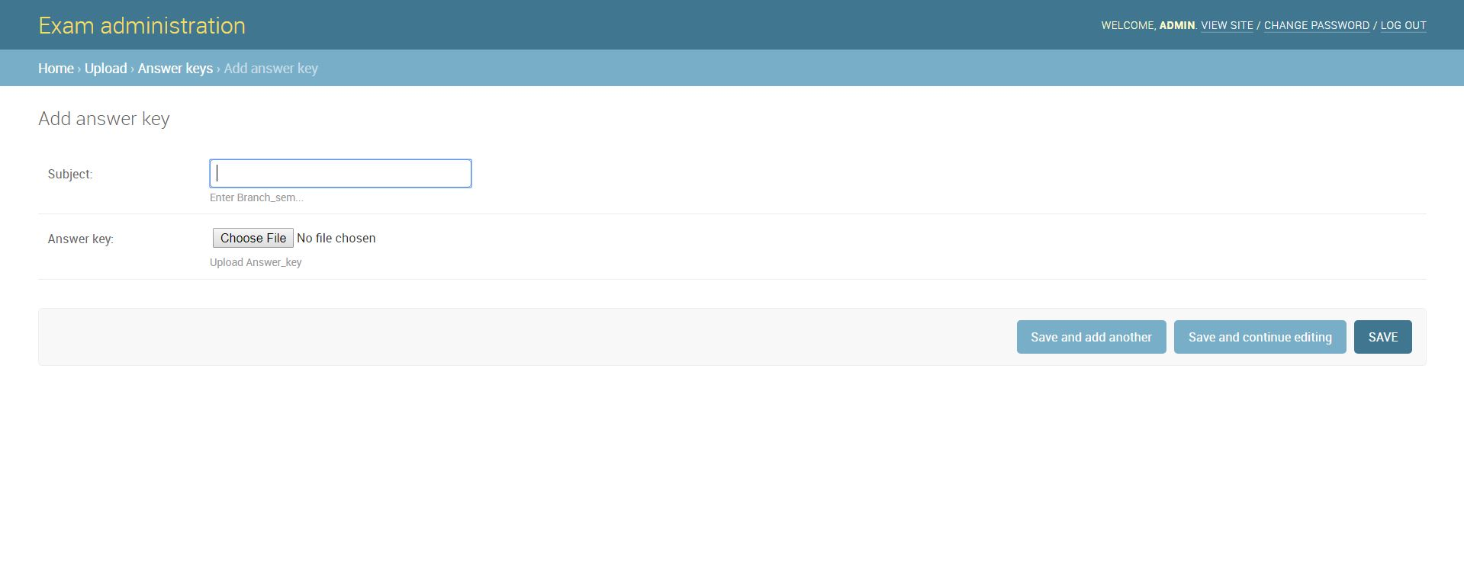
CSE Department, JECC

Slide 31
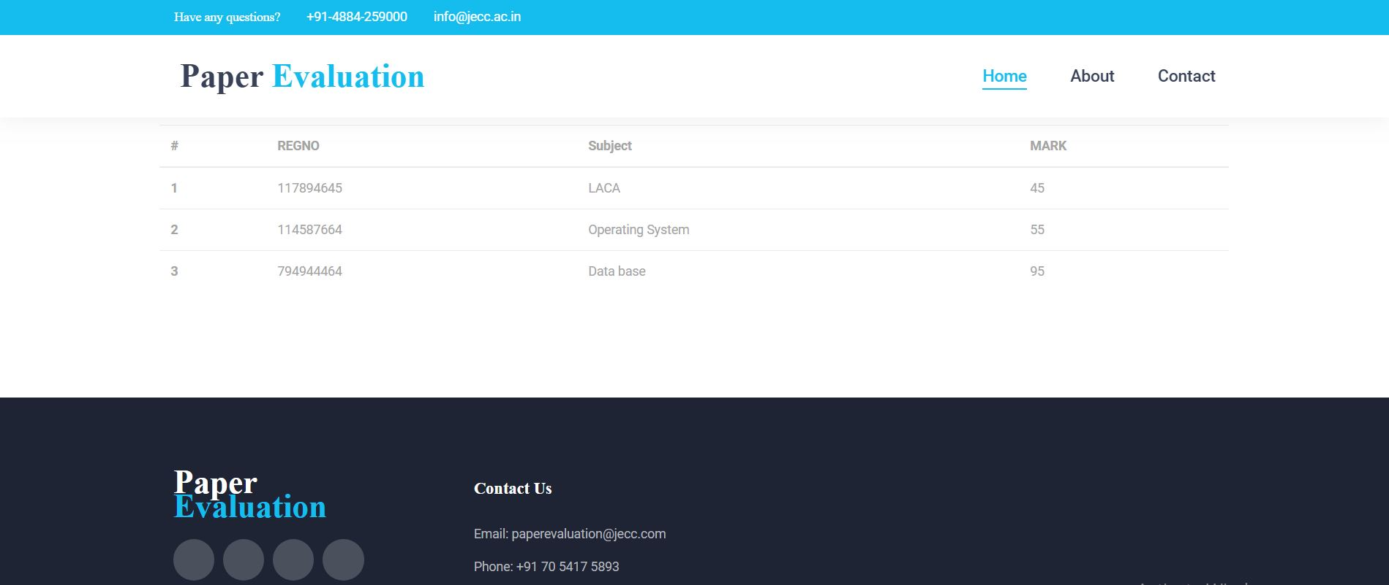
CSE Department, JECC

Slide 32
Proposed system
Detailed design of the project
We are planning to pre-process the image with PCA based conversion
Then we use Maximally Stable Extremal Regions (MSER) detection with Stroke Width Detector(SWD) to recognize characters or sentences
If the dimension is of the component is not in the range of Alphanumeric The component will be segmented and we will use Histogram of Oriented Gradients (HOG) algorithm to find out the figure and check whether it is required diagram (such as circuit diagram, data flow diagram etc..)
Then we compare the formed sentence using Self Organizing Maps(SOM) algorithm
Then we are planning to publish result in web site along with the key words that where missing from student’s answer
CSE Department, JECC
32

Slide 33
Proposed system
Advantages over other system
Can recognize diagrams
Comparatively high accuracy
Less effected by noise
Trust worthy
CSE Department, JECC

Slide 34
Application And Future Enhancement
Can be used in offices like village office for checking records of applicants
Can be used in hospitals for checking records of patients
Can be developed as android application for students to evaluate the paper their own
Can be developed as android application for Teachers to correct paper faster
CSE Department, JECC

Slide 35
Conclusion
Conclusion
This computerized autonomous paper evaluation system solves the problems of current evaluation system
Provides solution to manual mistakes
It is effective and feasibility
Can be used beyond educational field
CSE Department, JECC

Slide 36
References
[1] Radhika Patel and Suman K. Mitra, “Extracting Text from Degraded Document Image”,2015
[2]Tanupriya Choudhury, Kartikeya Jain, Lakshya Aggarwal, Ayushi Gupta, Garv Saxena, “Computerized Paper Evaluation Using Neural Network” ,2017
[3] Najwa-Maria Chidiac, Pascal Damien, Charles Yaacoub, “A Robust Algorithm for Text Extraction from Images”,2016
CSE Department, JECC

Slide 37


CSE Department, JECC
37

